Slide 1
Data Mining for Business
Unsupervised Learning
Lecture : Clustering
Dr. Kamesam

Slide 2


Data Mining /
Machine Learning
Supervised Learning
Unsupervised
Learning
Classification
Regression
Clustering
Association Rules
Linear Regression
Nonlinear Regression
DT,
ANN,
C&RT,
Log. Regression
Today
Apriori
Algorithm
K Means
Hierarchical
Clustering
MLR
ANN,
C&RT

Slide 3
What is Clustering?
Finding groups of objects such that objects in a group are similar to one another and different from the objects in other groups
Sometimes called classification by statisticians and sorting by psychologists and segmentation by people in marketing
Inter-cluster distances are maximized
Intra-cluster distances are minimized

Slide 4
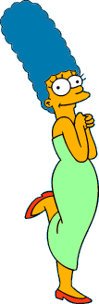











What is a natural grouping among these objects?
Clustering is subjective
Simpson's Family
Females
4
School Employees
Males

Slide 5
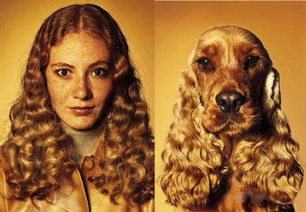
Similarity is Subjective
5

Slide 6
Conducting Cluster Analysis
Formulate the Problem
Select a Distance Measure
Select a Clustering Procedure
Decide on the Number of Clusters
Interpret and Profile Clusters
Assess the Validity of Clustering

Slide 7
Formulating the Problem
Most important is selecting the variables on which the clustering is based.
Inclusion of even one or two irrelevant variables may distort a clustering solution.
Variables selected should describe the similarity between objects in terms that are relevant to the research problem.
Should be selected based on past research, theory, or a consideration of the hypotheses being tested.

Slide 8
Select a Similarity Measure
Similarity measure can be correlations or distances
The most commonly used measure of similarity is the Euclidean distance. The city-block distance is also used.
If variables measured in vastly different units, we must NORMALIZE the data. Also eliminate outliers
Use of different similarity/distance measures may lead to different clustering results.
Hence, it is advisable to use different measures and compare the results.

Slide 9
DATA NORMALIZATION
Ex: Normalization of the Income Column: ( normalized scores between 0 and 1 )
Normalized income = (Income - MIN(Income) ) / (MAX (Income) - Min (Income) )
Note that the Normalized income has NO UNITS. Normalized Income is same whether initial data is in Dollars or thousands of dollars, or millions of dollars (scale invariant).

Slide 10
Intuitions behind desirable distance measure properties
D(A,B) = D(B,A) Symmetry
Otherwise you could claim “Alex looks like Bob, but Bob looks nothing like Alex.”
D(A,A) = 0 Constancy of Self-Similarity
Otherwise you could claim “Alex looks more like Bob, than Bob does.”
D(A,B) = 0 Iff A=B Positivity (Separation)
Otherwise there are objects in your world that are different, but you cannot tell apart.
D(A,B) ≤ D(A,C) + D(C,B) Triangular Inequality
Otherwise you could claim “Alex is very like Bob, and Alex is very like Carl, but Bob is very unlike Carl.”

Slide 11
Distance functions
 | X1 | (3, 7)
 | X2 | (8, 3)
 |  |  |  |  |  | distance
L2 | Eucleadian distance: sqrt[ (3-8)^2 + (7-3)^2] |  |  |  |  | 6.4031
L1 | manhattan distance: [abs(3-8) + abs (7-3)] |  |  |  |  | 9
L-inf | Max ( L-infinity) |  | Max [ abs(3-8) , abs(7-3) ] |  |  | 5
Notes:
L2和L1构成直角三角形，L1为直角边

Slide 12
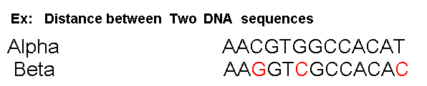
EDIT Distance
The edit distance between two strings is the number of inserts and deletes of characters needed to turn one into the other.
x = abcde ; y = bcduve.
Turn x into y by deleting a, then inserting u and v after d.
Edit distance = 3.

Slide 13

Notion of a Cluster can be Ambiguous
So tell me how many clusters do you see?
How many clusters?
Six Clusters
Two Clusters
Four Clusters

Slide 14
Types of Clusterings
A clustering is a set of clusters
Important distinction between hierarchical and partitional sets of clusters
Partitional Clustering
A division data objects into non-overlapping subsets (clusters) such that each data object is in exactly one subset
Hierarchical clustering
A set of nested clusters organized as a hierarchical tree

Slide 15




Partitional Clustering
Original Points
A Partitional Clustering

Slide 16
Types of Clusters: Center-Based
Center-based
A cluster is a set of objects such that an object in a cluster is closer (more similar) to the “center” of a cluster, than to the center of any other cluster
The center of a cluster is often a centroid, the average of all the points in the cluster (assuming numerical attributes), or a medoid, the most “representative” point of a cluster (used if there are categorical features)
4 center-based clusters

Slide 17
Centroid
Given the points below:
(2, 4, 5), (0,4,3), (7,5,6), (5,8,9)
( (2+0+7+5)/4, (4+4+5+8)/4, (5+3+6+9)/4 ) is the centroid
= (3.50, 5.25, 5.75) is the centroid
Notes:
Centroid 质心

Slide 18
Clustering Algorithms
K-means and its variants
Hierarchical clustering

Slide 19
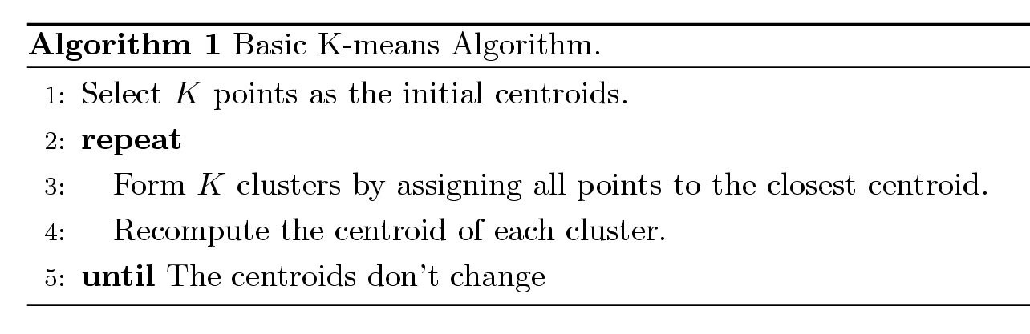
K-means Clustering
Partitional clustering approach
Each cluster is associated with a centroid (center point)
Each point is assigned to the cluster with the closest centroid
Number of clusters, K, must be specified
The basic algorithm is very simple

Slide 20
K-means Clustering
Ask user how many clusters they’d like. (e.g. k=3)
Randomly guess k cluster Center locations
Each datapoint finds out which Center it’s closest to.
Each Center finds the centroid of the points it owns…
…and jumps there
…Repeat until terminated!
5
4
3
2
1
0
0
1
2
3
4
5

Slide 21
K-means Clustering: Step 1
5
4
k₁
3
k₂
2
1
k₃
0
0
1
2
3
4
5
Notes:
随机选取centroid，每个点选择距离最小的中心，然后归到该中心代表的cluster

Slide 22
K-means Clustering
5
4
k₁
3
k₂
2
1
k₃
0
0
1
2
3
4
5
Notes:
Centroid移动

Slide 23
K-means Clustering
5
4
k₁
3
2
k₃
k₂
1
0
0
1
2
3
4
5
Notes:
得到新的centroid

Slide 24
K-means Clustering
5
4
k₁
3
2
k₃
k₂
1
0
0
1
2
3
4
5
Notes:
不断调整centroid的位置（这个过程中点的颜色有可能由于centroid的移动而改变）

Slide 25
K-means Clustering
k₁
k₂
k₃

Slide 26
K-means Clustering – Details
Initial centroids are often chosen randomly.
Clusters produced vary from one run to another.
The centroid is (typically) the mean of the points in the cluster
‘Closeness’ is measured by Euclidean distance, correlation, etc.
K-means will converge for common similarity measures mentioned above.
Most of the convergence happens in the first few iterations.
Often the stopping condition is changed to ‘Until relatively few points change clusters’
Notes:
k均值算法的目标函数优化过程是单调非增的（也就是每次的迭代至少不会让结果更糟），但是 k均值算法本身对达到收敛的迭代次数并没有给出理论保证。
当中心点不再变化时，或者说不再有某个点从一个分类转移到另一个分类时，我们就会停止计算。这个时候我们称该算法已经收敛。 算法运行过程中，中心点的大幅转移是在前几次迭代中产生的，后面的迭代中变动的幅度就会减小。也就是说，k-means算法的重点是在前期迭代，而后期的迭代只是细微的调整。
基于k-means的这种特点，我们可以将“没有点发生转移”弱化成“少于1%的点发生转移”来作为计算停止条件，这也是最普遍的做法。

Slide 27
Influence of initial centroids
If you recall, the K-Means algorithm requires that you specify an initial center for each of the clusters. We specified these randomly.
Unfortunately, the final clusters that you get, depend on the initial points. i.e; specifying different starting points can lead to different clusters.
In practice, once you finalize number of clusters, it is recommended to try different starting points, and eventually choose a clustering that is the best according to evaluation criteria.

Slide 28
Evaluating K-means Clusters
Most common measure is Sum of Squared Error (SSE)
For each point, the error is the distance to the nearest cluster
To get SSE, we square these errors and sum them.
We can show that to minimize SSE the best update strategy is to use the center of the cluster.
Given two clusters, we can choose the one with the smallest error
One easy way to reduce SSE is to increase K, the number of clusters
A good clustering with smaller K can have a lower SSE than a poor clustering with higher K

Slide 29
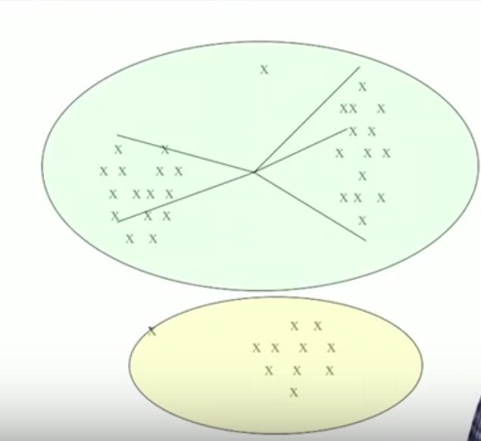

Slide 30
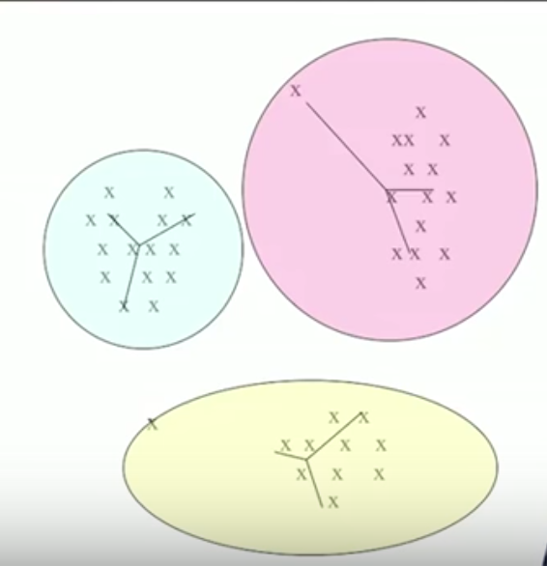

Slide 31
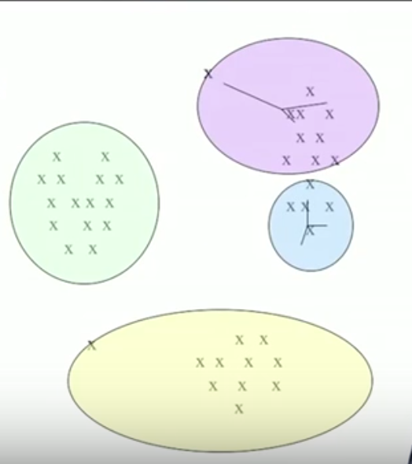

Slide 32
Evaluation of Clustering
Silhouette Measure of Cohesiveness and Separation
The score lies between -1 and 1. A score in the Good range is desirable (SPSS Modeler)
The silhouette measure averages, over all records, (B−A) / max(A,B), where A is the record's distance to its cluster center and B is the record's distance to the nearest cluster center that it doesn't belong to. A silhouette coefficient of 1 would mean that all cases are located directly on their cluster centers. A value of −1 would mean all cases are located on the cluster centers of some other cluster. A value of 0 means, on average, cases are equidistant between their own cluster center and the nearest other cluster.

Slide 33
Pre-processing and Post-processing
Pre-processing
Normalize the data (SPSS modeler does it for you)
Eliminate outliers
Post-processing
Eliminate small clusters that may represent outliers
Split ‘loose’ clusters, i.e., clusters with relatively high SSE
Merge clusters that are ‘close’ and that have relatively low SSE

Slide 34
Limitations of K-means
K-means has problems when clusters are of differing
Sizes (biased toward the larger clusters)
Densities
Non-globular shapes
K-means has problems when the data contains outliers.*
Notes:
对异常数据敏感
可以看到，Kmeans这种无监督学习的算法并不能保证聚类出来的"族群"是有"实际意义"的，即Kmeans得到的分类族群可能只是在欧式空间上相近的点集，但是实际上它们并不一定真的就属于同一个类别。另外一方面，Kmeans的分类结果和K值有强关联，如果我们传入了一个"不合理"的K值，有可能导致Kmeans的过拟合，最后得到一个"错误"的分类结果

Slide 35
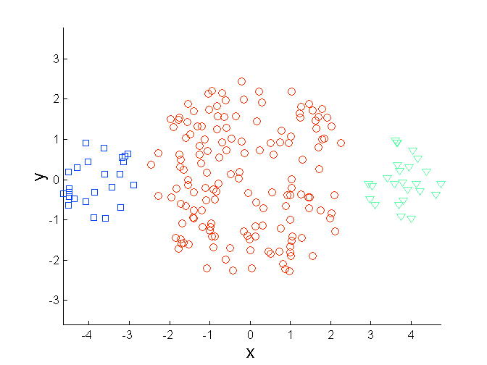
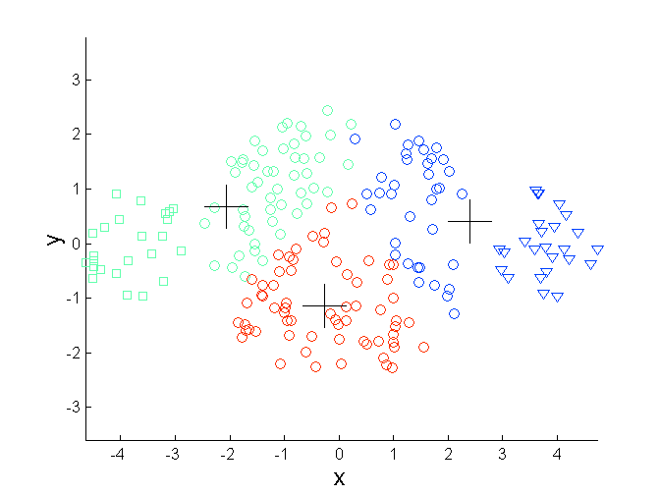
Limitations of K-means: Differing Sizes
Original Points
K-means (3 Clusters)

Slide 36
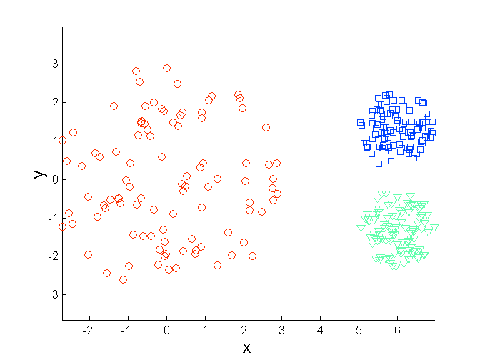
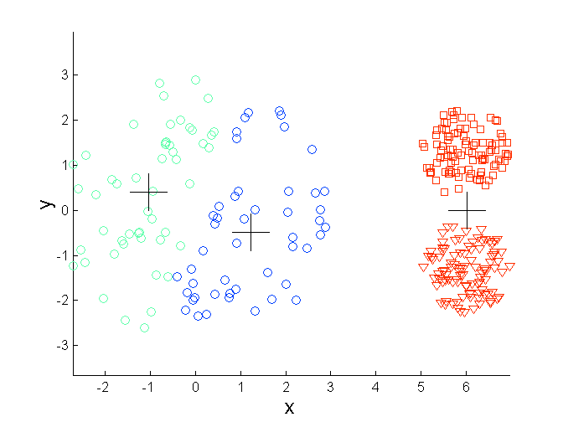
Limitations of K-means: Differing Density
Original Points
K-means (3 Clusters)

Slide 37
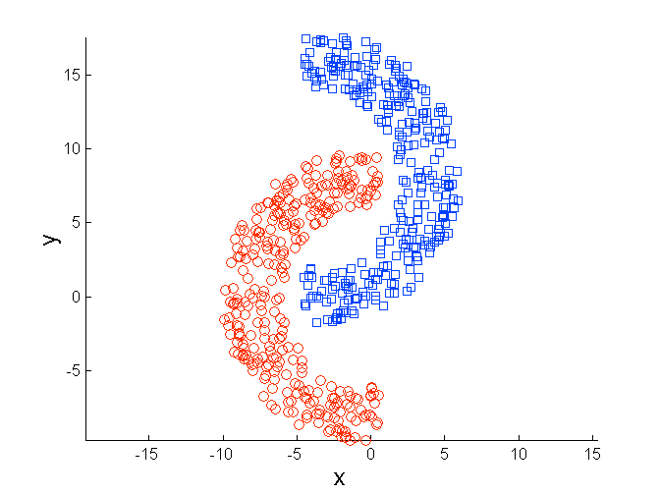
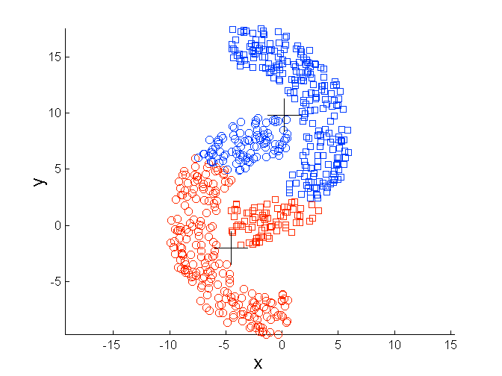
Limitations of K-means: Non-globular Shapes
Original Points
K-means (2 Clusters)
Notes:
k-means算法优缺点分析
优点 原理比较简单，实现也是很容易，收敛速度快
聚类效果较优 算法的可解释度比较强
缺点
K值的选取不好把握
聚类结果对初始类簇中心的选取较为敏感
对噪音和异常点比较的敏感
可能收敛到局部最小值，在大规模数据集上收敛较慢
只能发现球型类簇

Slide 38
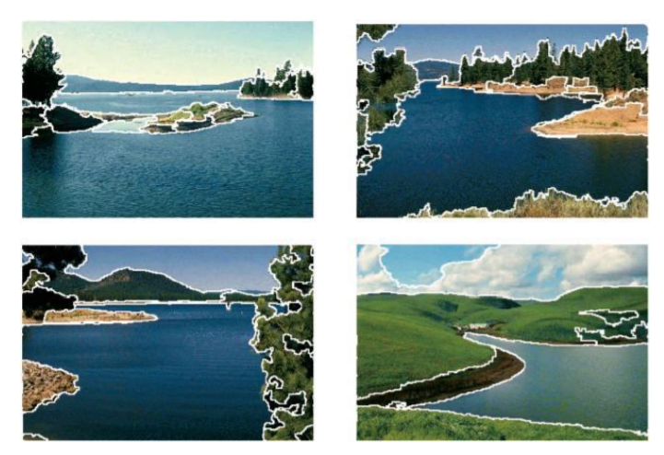
Image Segmentation in computer vision
Clustering is often a first step in Image Segmentation

Slide 39
Hierarchical Clustering

Slide 40
Hierarchical Clustering
Produces a set of nested clusters organized as a hierarchical tree
Can be visualized as a dendrogram
A tree like diagram that records the sequences of merges or splits

Slide 41
Dendrogram: Document Example
As clusters agglomerate, docs likely to fall into a hierarchy of “topics” or concepts.
agglomerate : collect or form into a mass or group
d3
d5
d1
d3,d4,d5
d4
d2
d1,d2
d4,d5
d3
Notes:
1.1 单链接聚类（single-linkage clustering）：类间距离定义为两类元素间的最短距离（取两两组合最短距离的那个）。在单链接聚类中，如果簇A到簇B的距离要比簇C到簇B的距离更近，则会将A和B先合并成一个新簇。（ppt中的方法）
1.2 最大链接聚类：类间距定义为两类元素间的最大距离（取两两组合最长距离的那个）。
1.3 平均链接聚类（average-linkage clustering）：类间距离定义为两类元素之间距离的平均值。

Slide 42
Example: n=6, k=3, closest pair of centroids
d6
d4
d3
d5
Centroid after
second step.
d1
d2
Centroid after first step.

Slide 43


Hierarchical Clustering
Traditional Hierarchical Clustering
Traditional Dendrogram
Simpsonian Dendrogram
Notes:
这种方法对给定的数据集进行层次似的分解，直到某种条件满足为止。具体又可分为“自底向上”和“自顶向下”两种方案。
例如：在“自底向上”方案中，初始时每个数据点组成一个单独的组，在接下来的迭代中，按一定的距离度量将相互邻近的组合并成一个组，直至所有的记录组成一个分组或者满足某个条件为止。代表算法有：BIRCH，CURE，CHAMELEON等。

Slide 44
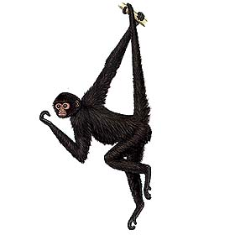
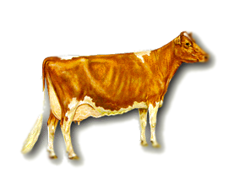
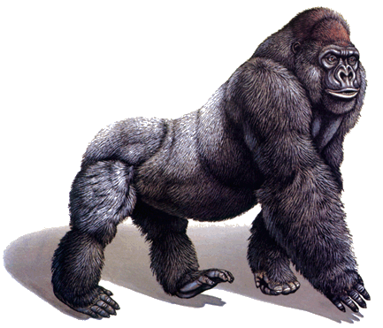

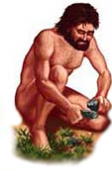
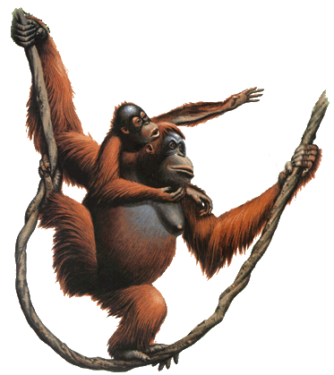
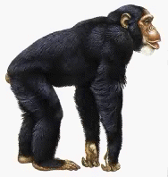
There is only one dataset that can be perfectly clustered using a hierarchy…
(Bovine:0.69395, (Spider Monkey 0.390, (Gibbon:0.36079,(Orang:0.33636,(Gorilla:0.17147,(Chimp:0.19268, Human:0.11927):0.08386):0.06124):0.15057):0.54939);
Notes:
物种基因十分相近，适合用hierarchy clustering

Slide 45

Note that hierarchies are commonly used to organize information, for example in a web portal.
Yahoo’s hierarchy is manually created, we will focus on automatic creation of hierarchies in data mining.
Business & Economy
B2B Finance Shopping Jobs
Aerospace Agriculture… Banking Bonds… Animals Apparel Career Workspace

Slide 46
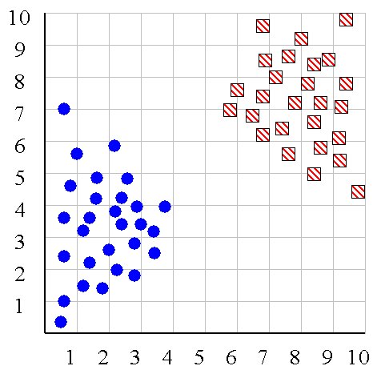
We can look at the dendrogram to determine the “correct” number of clusters. In this case, the two highly separated subtrees are highly suggestive of two clusters. (Things are rarely this clear cut, unfortunately)

Slide 47
Use of a dendrogram to detect outliers
The single isolated branch is suggestive of a data point that is very different to all others
Outlier
Notes:
异常数据对算法的影响

Slide 48
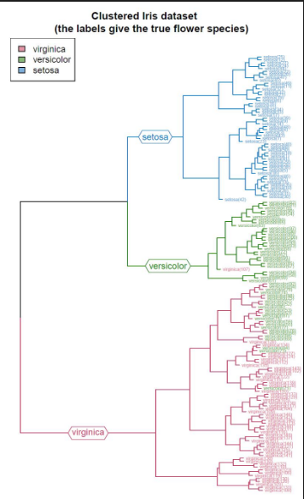
Hierarchical Clustering on the IRIS Dataset
Notes:
终止clustering的条件：
1. 固定类的数量：固定参数 k，当聚类数目为 k 时停止聚类。 使用这种停止准则需要我们对我们的场景要有较强的领域知识，即预先知道需要聚类的数量 2. 设定距离上限：设定域子集间距最大上限，如果在某一轮迭代中，所有的组件距离都超过该阈值，则停止聚类 使用这种停止准则，实际上隐含了一种假设，即相似的样本在特征空间上距离很近，且聚集在一个较小的区域内，彼此之间距离较近。而不同类别的样本在族群上彼此会拉开距离。 所以通过设定一定的距离上限，可以在对一个族群聚集完毕后及时收敛停止，开启新族群的聚集

Slide 49
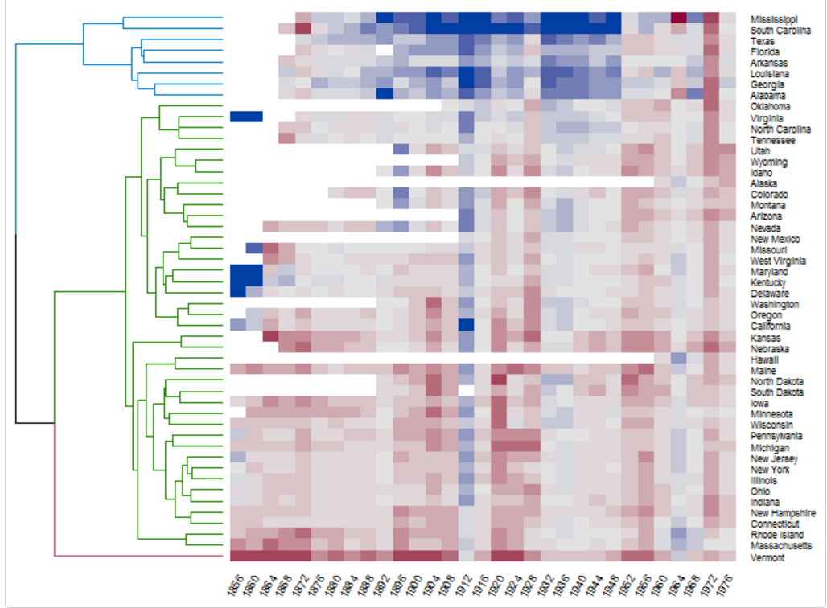

Slide 50
Perou et al (2000) showed that Hierarchical clustering can identify breast cancer subtypes. Patient Gene expression data is clustered on the next page. The clustergram is generated by MATLAB
Molecular portraits of human breast tumours
Charles M. Perou, Therese Sørlie, Michael B. Eisen, Matt van de Rijn, Stefanie S. Jeffrey, Christian A. Rees, Jonathan R. Pollack, Douglas T. Ross, Hilde Johnsen, Lars A. Akslen, Øystein Fluge, Alexander Pergamenschikov, Cheryl Williams, Shirley X. Zhu, Per E. Lønning, Anne-Lise Børresen-Dale, Patrick O. Brown and David Botstein
Nature 406, 747-752(17 August 2000)

Slide 51
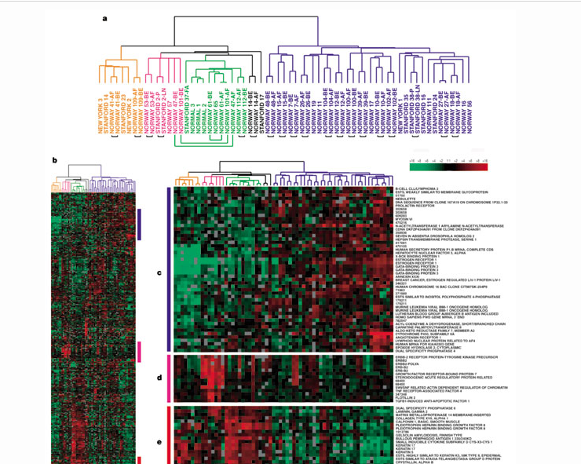
Breast Cancer Classification through Hierarchical Clustering

Slide 52
Hierarchical Clustering: MIN
5
1
3
5
2
1
2
3
6
4
4
Nested Clusters
Dendrogram

Slide 53
Final Comment on Cluster Validity
“The validation of clustering structures is the most difficult and frustrating part of cluster analysis.
Without a strong effort in this direction, cluster analysis will remain a black art accessible only to those true believers who have experience and great courage.”
Algorithms for Clustering Data, Jain and Dubes

Slide 54
Data mining is a process
science + craft + creativity + common sense
a process

Slide 55
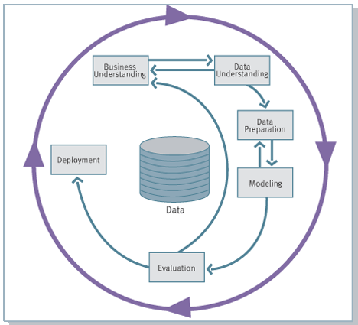
The CRISP Data Mining Process
Cross Industry Standard Process for Data Mining

Slide 56
The Data Mining Process

Slide 57
The Data Mining Process

Slide 58
Supervised vs. Unsupervised DM
Generally, supervised DM requires more effort and creativity
in the formulation of the business problem as one of our standard
problems (classification, regression)
Generally, evaluation is much more
straightforward for supervised DM;
evaluation requires more effort and
creativity for unsupervised DM

Slide 59
End Of Lecture

Slide 60
Other Distinctions Between Sets of Clusters
Exclusive versus non-exclusive
In non-exclusive clusterings points may belong to multiple clusters
Can represent multiple classes or ‘border’ points
Fuzzy versus non-fuzzy
In fuzzy clustering, a point belongs to every cluster with some weight between 0 and 1
Weights must sum to 1
Probabilistic clustering has similar characteristics
Partial versus complete
In some cases, we only want to cluster some of the data

Slide 61
Two different K-means Clusterings
Original Points
Optimal Clustering
Sub-optimal Clustering

Slide 62
Importance of Choosing Initial Centroids
If you happen to choose good initial centroids, then you will get this after 6 iterations

Slide 63
Importance of Choosing Initial Centroids
Good clustering

Slide 64
Importance of Choosing Initial Centroids …
Bad Clustering

Slide 65
10 Clusters Example
Starting with two initial centroids in one cluster of each pair of clusters

Slide 66











Hierarchal clustering can sometimes show patterns that are meaningless or spurious
For example, in this clustering, the tight grouping of Australia, Anguilla, St. Helena etc is meaningful, since all these countries are former UK colonies.
However the tight grouping of Niger and India is completely spurious, there is no connection between the two.
South Georgia &
South Sandwich
Islands
Serbia &
Montenegro
(Yugoslavia)
AUSTRALIA
St. Helena &
Dependencies
ANGUILLA
U.K.
FRANCE
NIGER
INDIA
IRELAND
BRAZIL

Slide 67
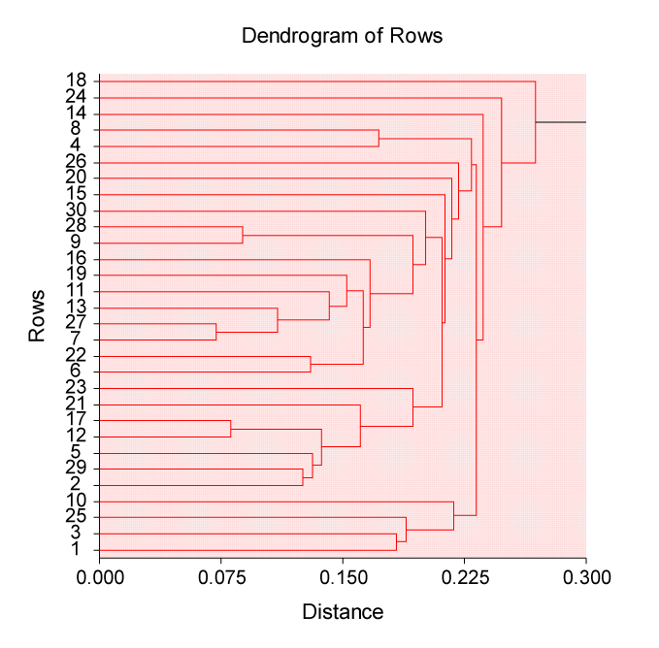
DENDOGRAM of the Housing Prices dataset

